Slide 1

Proposal PRESENTATION

Slide 2
My Beauty Organizer is launching the first, all-inclusive website which is tailored to the personal beauty consumer.

Slide 3
ProblemS
“I want a beauty website that has the latest beauty information.”
“I want to share my makeup looks with a community.”
“It would be great if I could have a place to see all the beauty products in my possession.”
“Please notify me when there is a sale on something in my wishlist.”
“Help me find my perfect match in this new foundation that just came out yesterday.”
“I don’t want an inventory app that I can only use on my iPhone.”
“I like website apps that are simple and easy to use.”

Slide 4
SOLUTION
The first, cloud-based, beauty-oriented website with a built-in inventory app that is easily accessible anytime, anywhere and from any platform.
Interface forms that are easy to navigate.
All products in one place (in the cloud) with current status.

Slide 5
What’s new?
Researched existing platforms
Websites
Temptalia is the closest website in concept
Excellent blogging site and information
Has no inventory feature
Has color comparisons, however underlying technology not shown. Is it manual or automatic?
iPhone has the most apps
Beauty Keeper allows users to keep track of expiring products
Limited usability
Need to manually input product
Lovelyloot inventories makeup
Fairly up-to-date
Reduncancy in lists
Cannot sort
Unable to select multiple shades from single product
MiaMia inventories makeup and shares looks
More of a social app
Difficult to navigate
Unable to select multiple shades from single product
Unable to sort inventory
MyBeautyCache (3.99)
Great organization with lists and statistics
Horrible inventory capability – you have to manually input your items
Scraped idea of optimizing site colors to user monitor

Slide 6
Features
Allows users to create a personal inventory of makeup items utilizing a graphical interface
Shopping lists can be emailed
Looks can be uploaded and shared socially with a list of the associated products
Quick access to inventory anywhere
Sales and promotions listed in blog and/or notifications sent to user
Ability to purchase items with built-in links to stores
Search site’s reviews before you buy

Slide 7
Issues
Figuring out how much to charge to cover the cost of data storage and retrieval
How to research potential customers to gauge interest in the inventory aspect
How to contact companies for affiliate links to earn income
Optimizing the site for ease of use on most devices
Optimizing inventory aspect for speed to avoid disuse due to performance issues.
Finding an easier manner of adding products to the initial database of inventory choices.
Can companies be contacted and they supply an excel spreadsheet of products?

Slide 8
Risks
Database costs outweighing income earned
Wait time of website adoption exceeding cost time and monetary costs of construction and maintenance of site

Slide 9
Priorities
Site already has basic implementation, so working connection to database is a primary issue

Slide 10
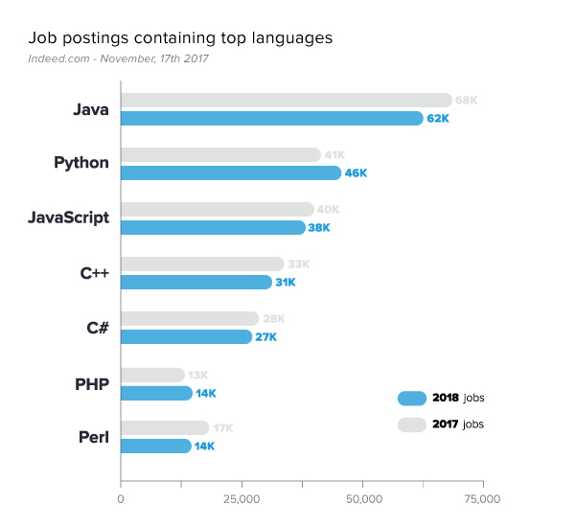


Justifications
Excellent learning experience for anyone interested in cross-platform
Opportunity to learn PHP, one of the few top languages that is growing in demanding
Entrance on the ground floor to a project with excellent opportunity for revenue growth.

Slide 11
Initial Plan
Create 3 separate CSS optimized for mobile, pads and laptops/desktops
Redesign the website to be more streamlined and modern
Add a login
Build rudimentary database to begin data entry

Slide 12











Shopping List
Search
Add Item
Reports
Looks
Wishlist
Help
Settings
Logout

Slide 13






FIND ITEM
PIC | Brand | Type | Name | Color | Color Family
 | Becca | Blush | Mineral Blush | Gypsy | Pinks
 | Clinique | Concealer | Airbrush Concealer | Nude Beige | Skin
 | Estee Lauder | Lipstick | Pure Color Envy Matte Lipstick | Ruby | Reds
BACK
SORT
Search for item

Slide 14
Technology stack
USER
INTERNET
HOSTING
GoDaddy
PROGRAMMING
HTML
CSS
JavaScript
PHP
SQL
TESTING
User Testing
(CREATE and online)
Google Site Speed
Google Search Console
W3C Markup Validation
DATABASE
MySQL

Slide 15
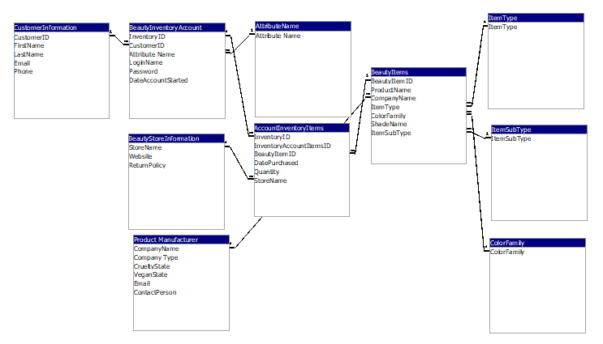
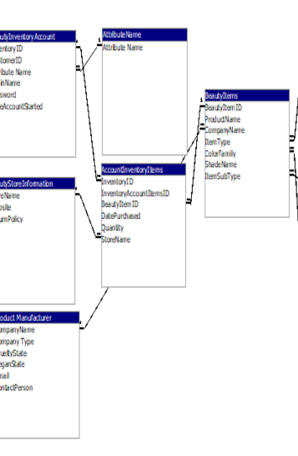
Data Structure
Use GoDaddy as hosting site
MySQL database
ERD

Slide 17
Documentation
Github readme

Slide 18
Proposed Timeline
Jan 30, 2018 | Final Proposal
Feb 06, 2018 | 1st Iteration - Login
Feb 20, 2018 | 2nd Iteration
Mar 06, 2018 | 3rd Iteration
Mar 20, 2018 | 4th Iteration
Apr 03, 2018 | 5th Iteration
Apr 17, 2018 | Final Product
Apr 24, 2018 | Live Testing
Apr 27, 2018 | CREATE

Slide 19
PROPOSED ROLES
Laura (Manager,
Knowledge set – html, css, javascript
Learning Objectives – PHP, SQL
ChinChin
Knowledge set – html, css, javascript, graphics, testing
Learning Objectives – PHP, SQL
Third Person Initiatives
Create a shade comparison capability that reports percent match which would greatly increase the desire to use the website as many want to be able to match their existing foundation shade to a new launch as well as find product dupes for cheaper versions of high-end products – huge drawing point!!!
Colormatch photos taken using a reference color chart – huge reliability of color abiity that supports the above and increases user experience and confidence.

